Slide 1














Set up Intrusion Prevention System with Snort

Slide 2

Intruduction
Snort is the foremost Open Source Intrusion Prevention System in the world, it uses a series of rules that help define malicious network activity and uses those rules to find packets that match against them and generates alerts for users.
Snort has three primary uses: As a packet sniffer like tcpdump, as a packet logger, which is useful for network traffic debugging, or it can be used as a full-blown network intrusion prevention system. Snort can be downloaded and configured for personal and business use alike

Slide 3
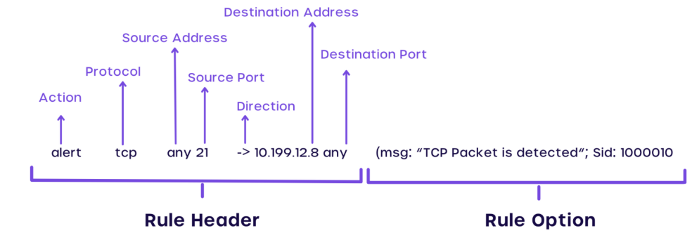
Snort rule format

Slide 4
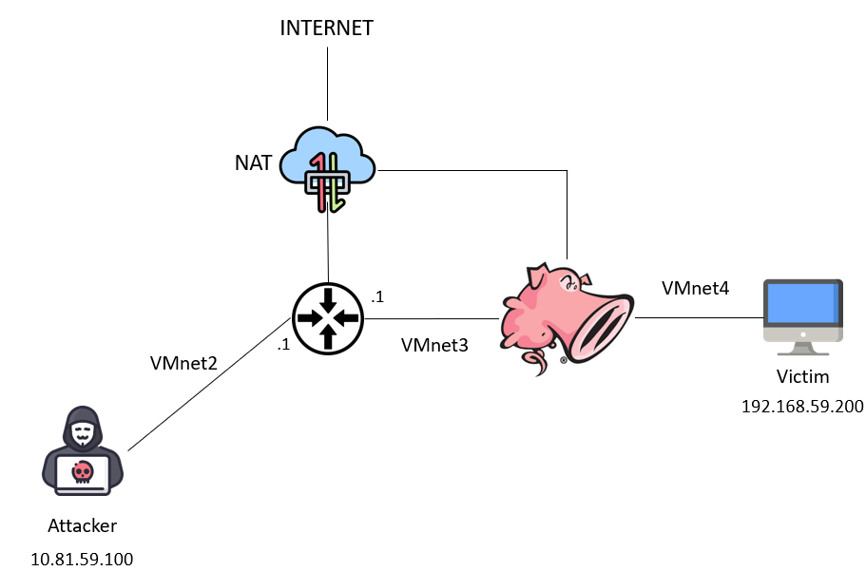
Topology

Slide 5
DEMO

Slide 6
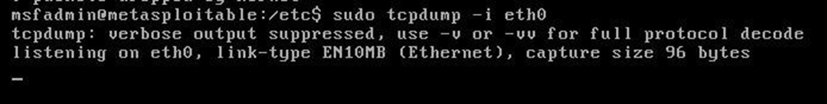
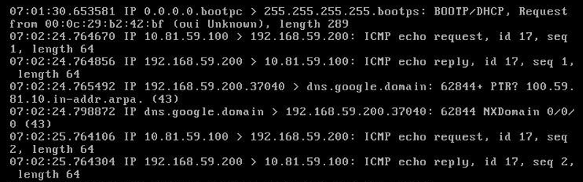
1. Drop ICMP packet to Victim
Before apply rule, Attacker can still ping to Victim
10.81.59.100 (attacker) -> 192.168.59.200 (victim)

Slide 7
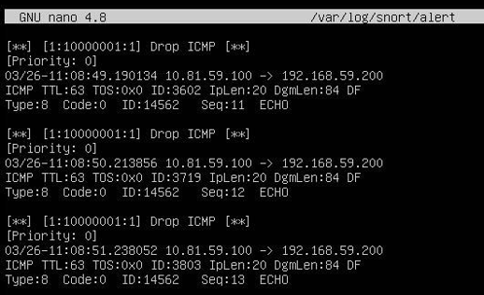
1.Drop ICMP packet to Victim
Rule content
drop icmp any any -> 192.168.59.200 any (msg: “Drop ICMP”; sid: 10000001; rev: 1;)
After applying rule, victim does not receive any more ICMP packet. Check log from /var/log/snort/alert, we see that Snort dropped attacker’s ICMP packet.

Slide 8
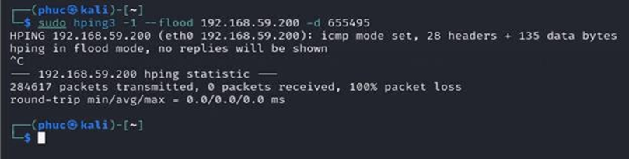
2. Prevent ICMP flood attack
Use hping3 to constantly sends ICMP packets with a size of 655495 bytes to the victim without waiting for responses from victim.
sudo hping3 -1 --flood 192.168.59.200 -d 655495

Slide 9
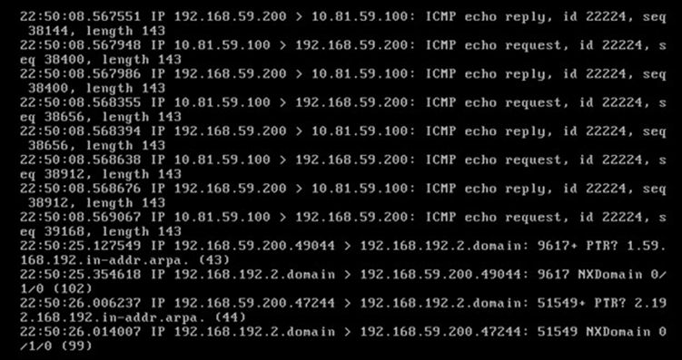
2. Prevent ICMP flood attack
Run tcpdump on victim machine to see ICMP packets sent by attacker

Slide 10
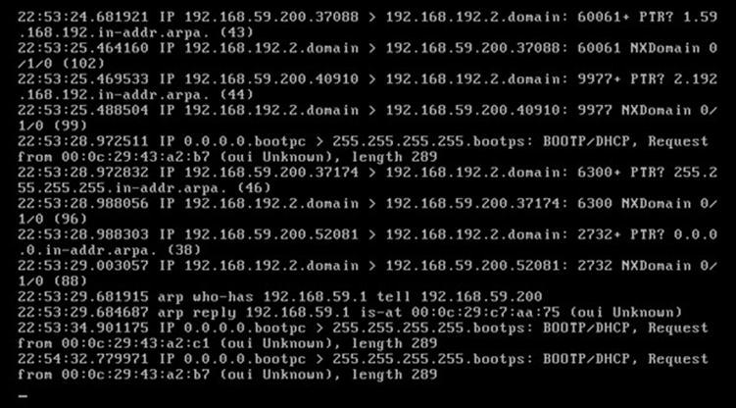
2. Prevent ICMP flood attack
Rule content
drop icmp any any -> 192.168.59.200 any (msg: "ICMP Flood Found"; threshold: type limit, track by_src, count 23, seconds 5; sid: 1000001; rev:1;)
If any source sends an icmp packet to the victim machine more than 23 times/5 seconds, Snort will block icmp packets from that source.
After applying rule and perform the attack again, we see that victim no more receive any ICMP packets from attacker

Slide 11
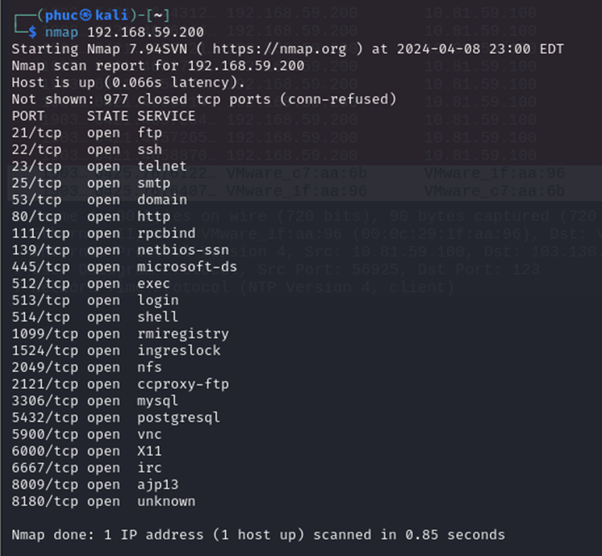
3. Monitor service access
Use nmap to scan open port on victim machine

Slide 12
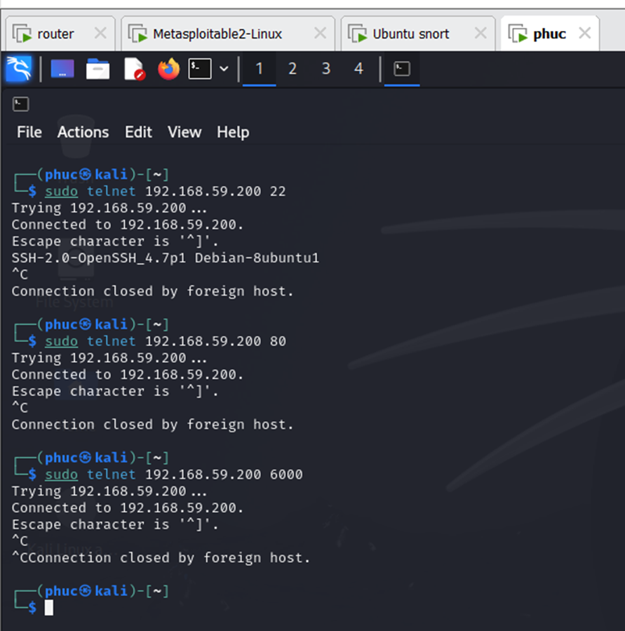
3. Monitor service access
Use telnet to access some ports.
I want the attacker to only be able to access the service on these ports

Slide 13
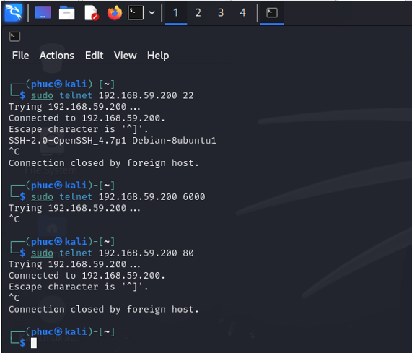
3. Monitor service access
Rule content
drop tcp any any -> 192.168.59.200 ![21,22,23,25,53,80,111] (msg:"Drop access to outside port"; sid:1002; rev:1;)
This rule will block packets to the victim machine 192.168.59.200 if those packets do not pass through a port in the specified port range.
As we see, attack can still use telnet to access service on port 22 and port 80 but cannot access service on port 6000

Slide 14
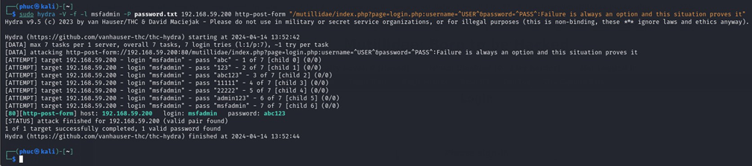
4. Prevent basic brute-force attack
Use hydra to perform a simple brute-force attack
sudo hydra -V -f -l msfadmin -P password.txt 192.168.59.200 http-post-form "/mutillidae/index.php?page=login.php:username=^USER^&password=^PASS^:Failure is always an option and this situation proves it"

Slide 15
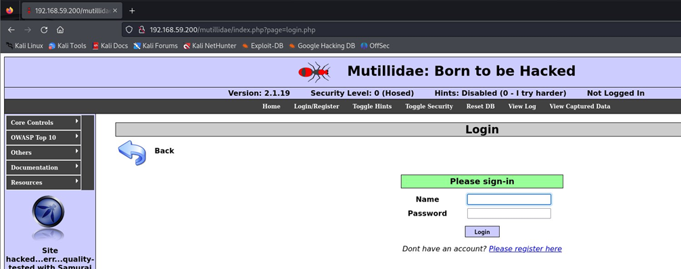
4. Prevent basic brute-force attack
Rule content
Drop tcp any any -> 192.168.59.200 80 (msg: “Brute-force Found”; content: “PASS”; nocase; threshold:type both, track by_src,count 5, seconds60; sid:1003; rev:1;)
If a packet from any source contains the string "PASS" (non-case sensitive) sent to victim through port 80 more than 5 times/60s, the packet from that source will be blocked.
After applying rule, attacker can still access the website normally

Slide 16
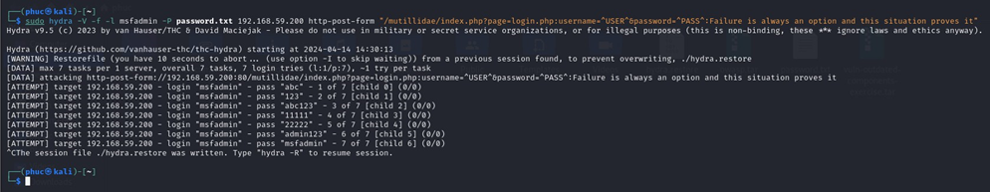
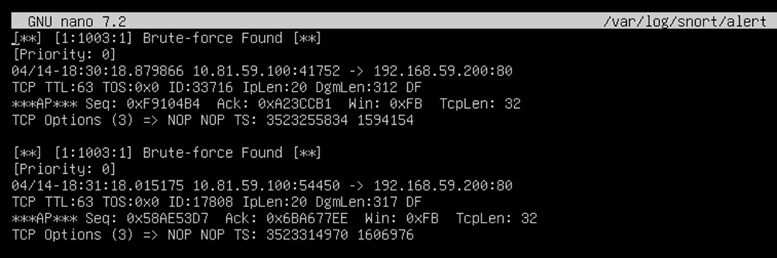
4. Prevent basic brute-force attack
Perform the attack again
Check log to see the result

Slide 17
4. Prevent basic brute-force attack
Perform the attack again
Check log to see the result

Slide 18
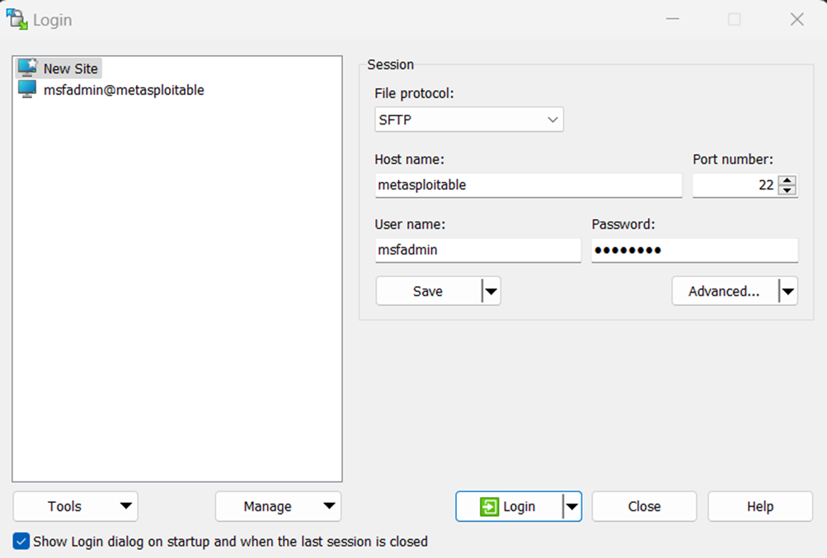
4. Prevent OS scan
Use WinSCP to get pcap file from the victim's machine via SSH

Slide 19
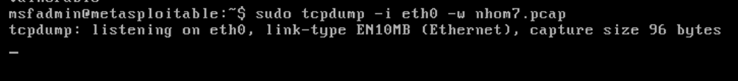
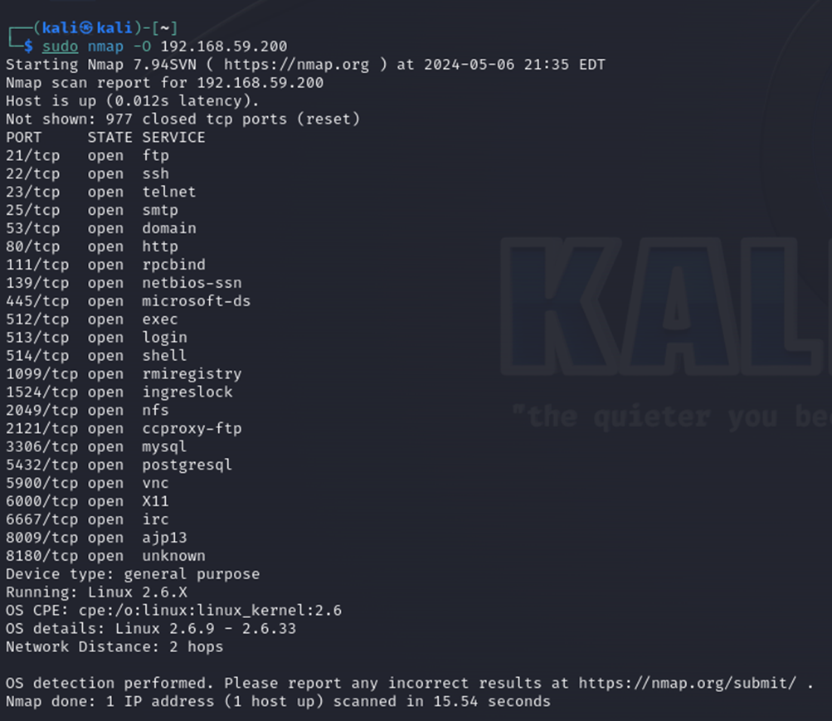
4. Prevent OS scan
Use tcpdump to capture network traffic from attack
Use nmap to scan victim’s OS
sudo nmap -O 192.168.59.200

Slide 20
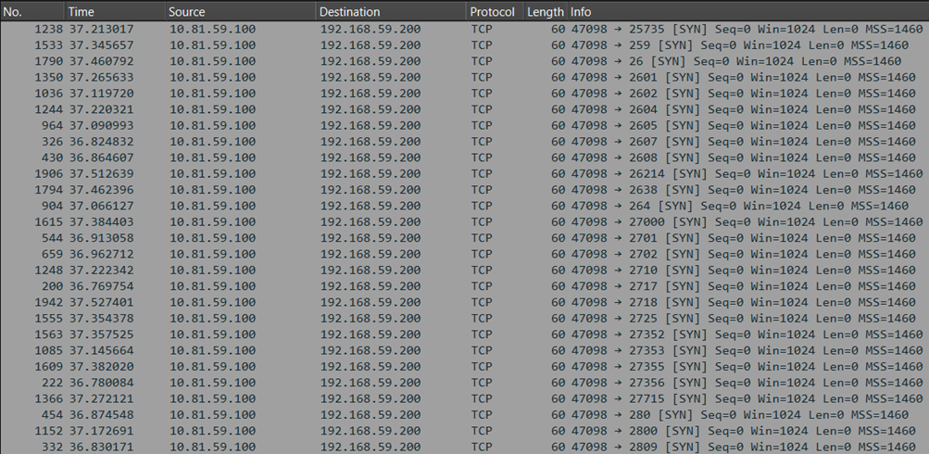
4. Prevent OS scan
Analyze pcap file, we found that attacker constantly sent lot of SYN packets to victim

Slide 21
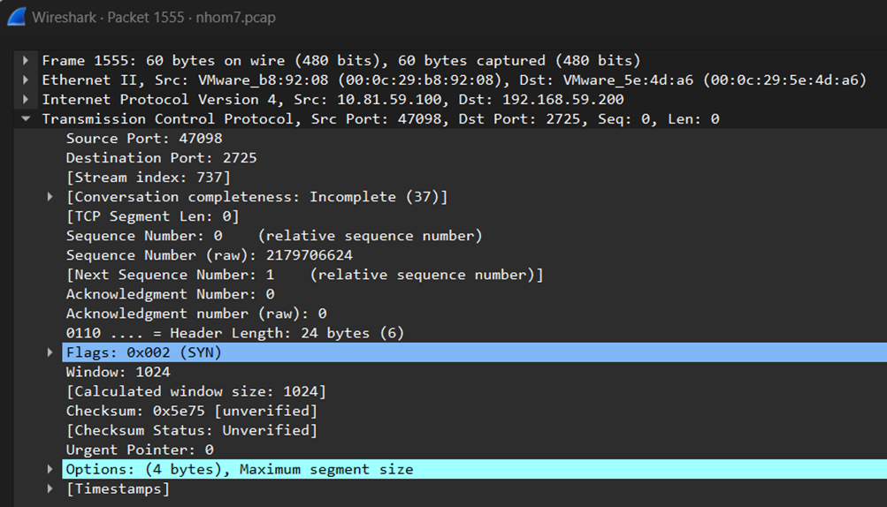
4. Prevent OS scan
Checking the details of SYN packets, there are some things in common: The "segment length" values are all 0 and the "window size" value is 1024.

Slide 22
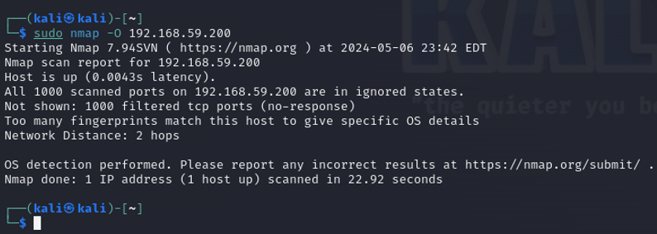
4. Prevent OS scan
Rule content
drop tcp any any -> 192.168.59.200 any (msg:"NMAP OS scan detected”; flags:S; dsize:0; window:1024; sid:100001; rev:1;)
nmap scan OS victim has been blocked

Slide 23
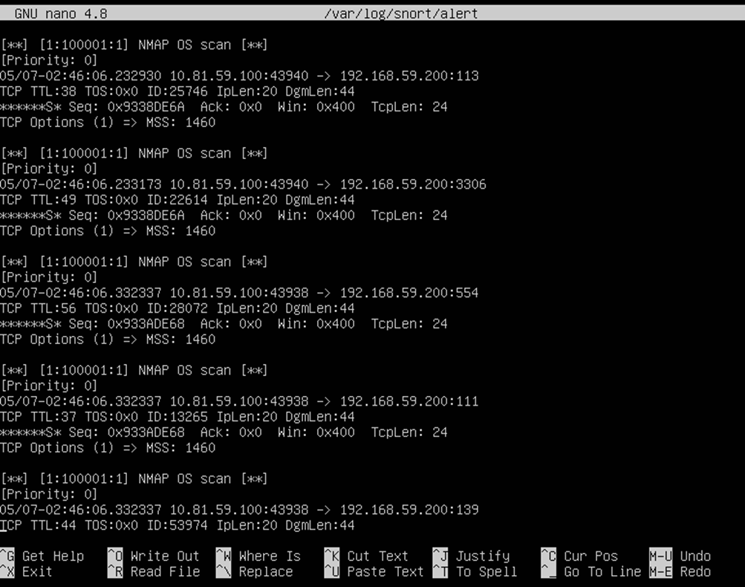
4. Prevent OS scan
Check Snort log to see result

Slide 24
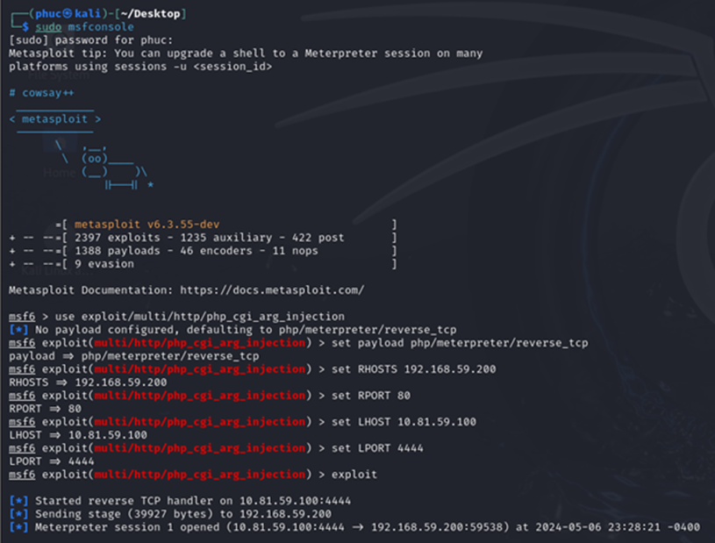
5. Prevent PHP CGI Argument Injection
Start msfconsole and prepare parameters for attack

Slide 25
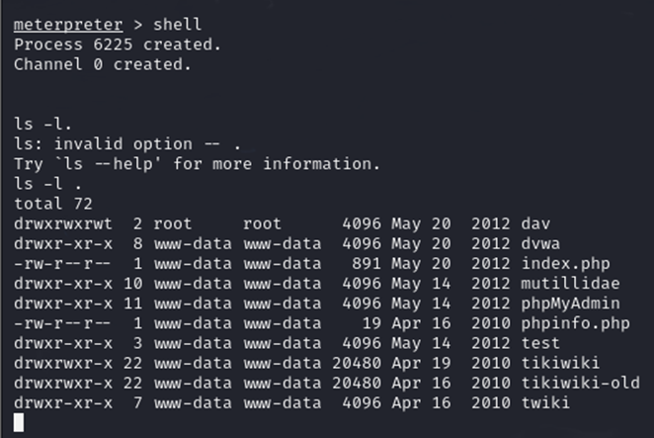
5. Prevent PHP CGI Argument Injection
Perform attack

Slide 26
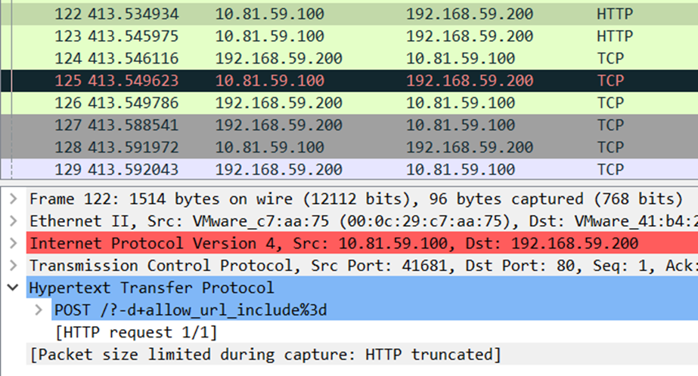
5. Prevent PHP CGI Argument Injection
Analyze pcap file, we see that the attacker's HTTP request contains the content "?-"

Slide 27
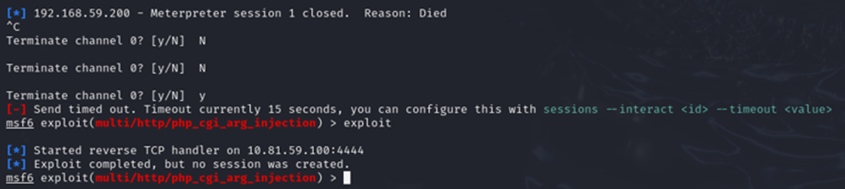
5. Prevent PHP CGI Argument Injection
Rule content
Drop tcp any any -> 192.168.59.200 any (msg:“Found PHP CGI Argument Injection”; content:“?-”; sid:10000002; rev:1;)
After apply rule, Snort has blocked the attack

Slide 28
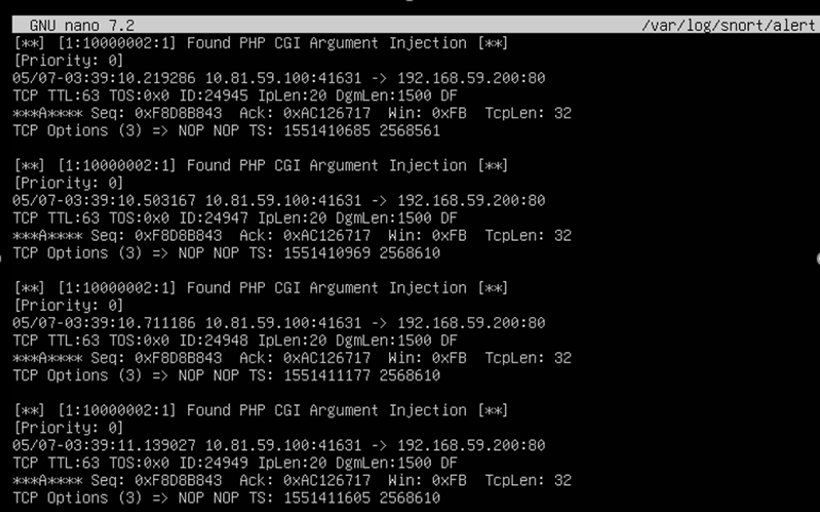
5. Prevent PHP CGI Argument Injection
Check log to see the result

Slide 29
Thanks for watching!
www.reallygreatsite.com

